Slide 1
Lecture 5 - Requirements
Notes:
Establishing system level requirements and allocating them to subsystems is one of the most important jobs that a systems engineer performs. I can’t remember a time when the root cause of a program in trouble was not “bad requirements” or “lack of stability in requirements”. Having said that, even on the best projects, requirements can be in flux.
The best thing that a systems engineer can do is to write down what they know about requirements to make them visible and point out when efforts do not meet requirements or when multiple requirements are inconsistent or incompatible.
Some people get very involved with the administrative detail of requirements and requirements traceability. When systems engineers get wrapped up in this “administrivia” they lose awareness of the larger picture. The purpose of this lecture is to communicate the basics of requirements generation and management so you can get the job done without getting lost in the trivia.
In my view, these are the immutable basics. You don’t need to do much more than this but it gets hairy if you start doing less.

Slide 2
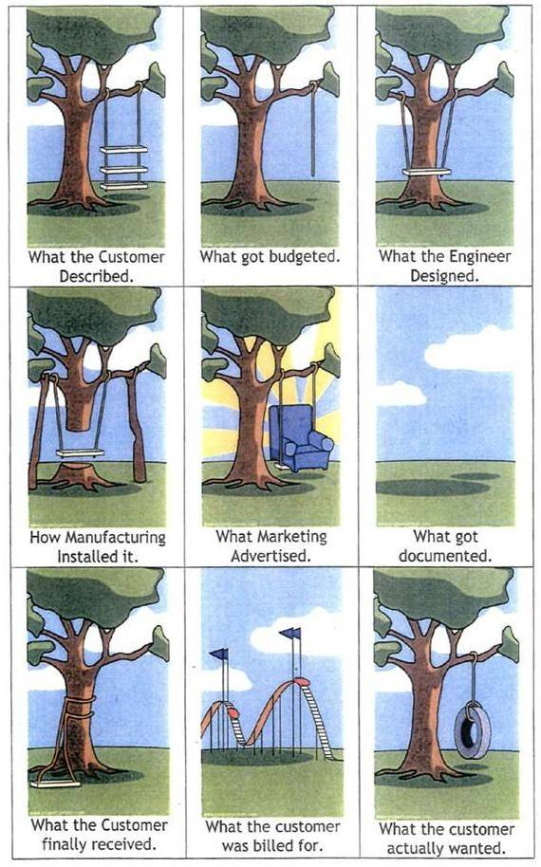
Notes:
How a project is viewed by the different communities building a swing.
The customer description is the requirement, and that’s where most problems start.
When budgets are not compatible with requirements, the problems start right away because you are in budget catchup mode. Budgets should reflect requirements.
Design must reflect requirements.
Manufacturing must not change requirements without evaluation.

Slide 3
Topics
Requirement Grammar
Proper formation of requirements
Definition of verification, certification, qualification, validation
Testability of requirements - ITAD
Decomposition
Level A, B, C
Traceability matrices

Slide 4
What is a requirement ?
A requirement is a declarative statement of what a system must do in order to meet its mandatory function
A requirement must be able to be understood by itself
  It can reference other requirements or be in context of other requirements
A requirement must be stated so that the designed and constructed system can be examined to determine if the requirement was met or not
A requirement does not proscribe how the system must be designed or constructed.
  It only states what it is mandatory for the system to do
Requirements should not be phrased in negative statements
  Except for trivial cases it is impossible to examine a system to determine if a negative statement has been met by a system
  “Impossible to prove a negative”

Slide 5
Requirement Grammar
English grammar has been perverted somewhat for requirements specifications
The word “shall” is normally grammatically only used for first person declarative statements (“I shall” or “we shall”) and the word “will” is used for second and third person declaratives (“you will”, “he, she or it will”)
For requirements specifications, the word “shall” indicates a requirement and the word “will” indicates a non mandatory goal or desire

Slide 6
Requirement Quiz – Specification for a hypothetical “Astonisher Aircraft Model 505”
Statement | Is this a Valid Requirement ? Why ?
The Astonisher Aircraft 505 shall carry 200 passengers and baggage.
The Astonisher 505 shall never crash.
The Astonisher 505 will carry 2000 lbs of fuel.
The Astonisher 505 shall be the most comfortable aircraft in service by the year 2010

Slide 7
Requirement Quiz – Specification for a hypothetical “Astonisher Aircraft Model 505”
Statement | Is this a Valid Requirement ? Why ?
The Astonisher Aircraft 505 shall carry 200 passengers and baggage. | Yes – proper use of shall, requirement can easily be determined by inspection
The Astonisher 505 shall never crash. | No – uses a negative in a requirement - although avoiding crashes is a valid goal, how can you ever prove that it will never crash
The Astonisher 505 will carry 2000 lbs of fuel. | No – uses the term will indicating a goal
The Astonisher 505 shall be the most comfortable aircraft in service by the year 2010 | No – can’t determine comfort. Comfortable to whom ? In what way ?

Slide 8
Fixing the statements – Specification for a hypothetical “Astonisher Aircraft Model 505”
Statement | Better Requirements Statement
The Astonisher Aircraft 505 shall carry 200 passengers and baggage. | Fine as is
The Astonisher 505 shall never crash. | The Astonisher 505 shall contain a Ground Proximity Warning System to reduce the risk of Controlled Flight Into Terrain (CFIT).
The Astonisher 505 will carry 2000 lbs of fuel. | The Astonisher 505 shall carry 200 lbs of fuel.
The Astonisher 505 shall be the most comfortable aircraft in service by the year 2010 | The Astonisher 505 shall contain provisions for 50 percent more legroom than the minimum required to carry a 95% american male population

Slide 9
Requirement Numbering
All requirements are numbered for unambiguous identification
Sometimes the paragraph number where the requirement resides in the requirement specification is used
Other times a simpler sequential numbering is used

Slide 10
Verification, Validation and Certification
Verification – Determination that an item meets its requirements
Validation – Determination an item meets its intended purpose in its operating environment
  Alternate definition – for models (e.g. Aerodynamic database), design environments and simulations, validation is the determination that the item accurately reflects the subject being modeled ( i.e. it is a valid model or database)
  Alternate definition – for software, validation is the determination that requirements are correct and complete (i.e. it is a valid requirement)
Certification – a formal documentation of the verification and validation process. Certification requires review and assessment of verification and validation records by a certifying authority.

Slide 11
Example of Verification of Invalid Software Requirement
If the requirements are wrong, it is possible to verify that the software is designed per requirement even though the requirement is wrong
For example
  Let’s say that for a function, the software must compute the hypotenuse of a right triangle
  Proper equation is sqrt(side a^2 + side b^2)
  But if the requirements were in error and stated sqrt(a+b) it would be possible to code the software and test the software to requirements but the software is invalid
    This type of requirement error is very different from a coding error
    A coding error is where the code doesn’t correctly implement the requirement

Slide 12
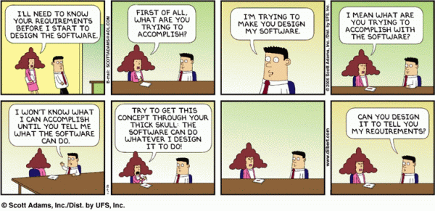

Slide 13
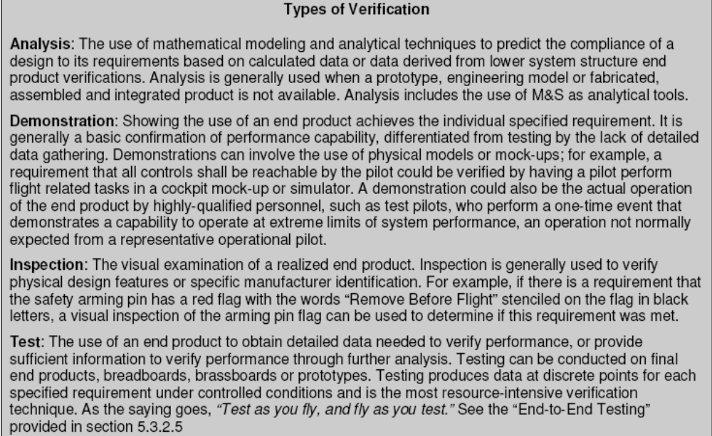
ITAD – Inspection, Test, Analysis, Demonstration
From NASA/SP-2007-6105 Rev 1 Systems Engineering Handbook

Slide 14
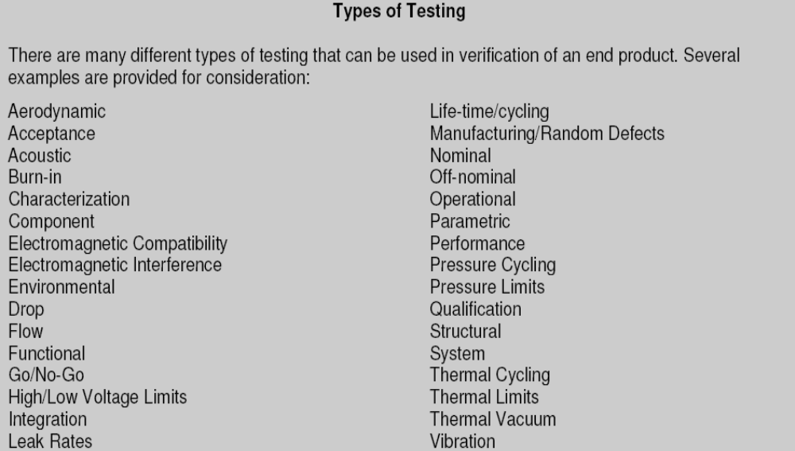
Types of Testing
From NASA/SP-2007-6105 Rev 1 Systems Engineering Handbook

Slide 15
System Test
Aerodynamic – typically subscale wind tunnel or drop model
Acceptance – tests performed on each article as it is produced. Used to verify workmanship not design capability
Acoustic – submitting a design to a fluctuating pressure environment – typically performed once for a design using large low frequency speakers
Burn-In – accumulating time on a production article to clear failures due to infant mortality – see attached chart on bathtub curve for reliability
Characterization – typically performed once per design to determine design capability
Component – test on a single component versus integrated assembly
Electromagnetic Compatibility – to prove elements of a design don’t interfere with other elements of a design and that they work together (transmitter- receiver)
Electromagnetic Interference – determine susceptibility to interference or determine likelihood to emit interference

Slide 16
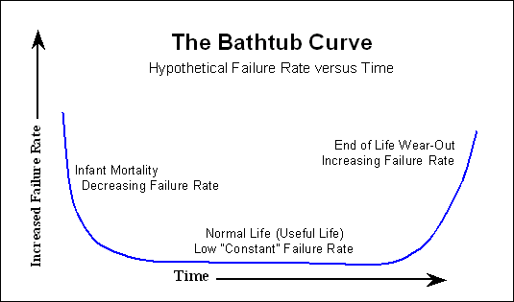
Burn-In Testing takes hardware to here prior to delivery
Notes:
Reliability of many types of hardware, particularly electronics, follows the bathtub model. Products with systematic flaws, i.e. they don’t work properly, are usually identified early. Weak materials are also usually identified in the first few cycles of use. In electronics, parts usually fail in the first few times they are exposed to warmer operating temperatures for the first time as heating expands materials and weak spots of breaks in materials are exposed, opening up circuits. Once the product has been exposed to multiple heating and cooling cycles, these weak or broken parts have been exposed or fail due to metal fatigue.
Once through this period of “infant mortality” most electronics components can run for years without problems. To avoid these “infant failures” after delivering products, it is often very effective to burn-=in electronics – or run them through multiple periods of extended on-off cycling, to reveal the weak components .
Failure rate starts to build up at the end of life as components fatigue through their useful life. The rise in failures is usually due to the probabilistic scatter inherent in fatigue processes.
CLASS Activity: To understand probabilistic scatter in metal fatigue, hand every student a paper clip and have them bend it back and forth, counting the number of times until it breaks, Plot the number of failures versus the number of cycles.

Slide 17
System Testing (cont’d)
Environmental – compatibility with design environment (temp, pressure, vibration)
Drop – typically to prove design capability for handling or workmanship as an acceptance test
Flow – flow liquids or gases through a system
Functional – verify function of the system
Go/No-Go – a test that may simply read static values such as supply voltages and temperatures or may actually function a system to determine its readiness to perform an operation
High/Low Voltage Limits – a check of voltages against operating limits – normally a type of go/no-go test
Integration – verifying performance when multiple design elements are connected together

Slide 18
System Testing (cont’d)
Leak Test – load a system with liquids or gases and pressurize to operational pressure to determine leak rate. May be used in a cabin or crew volume for pressurized cabins.
Life Time/Cycling – typically a one time design component test where a component is functioned (usually between two states such as on/off, open closed, started/stopped) to prove or determine the time between failures
Manufacturing/Random Defect – usually inspection or functional test of a subset of components in a production run
Nominal – testing under normal operating conditions and modes
Off-Nominal – testing under unusual conditions or operating mode

Slide 19
System Testing (cont’d)
Parametric – holding multiple operating settings constant and then varying one parameter at a time to determine system response to that one parameter
Performance – similar to characterization test
Pressure Cycling – pressurizing and de-pressurizing a system to determine fatigue and fracture limits of structures
Pressure Limit – Demonstrate static load capability – also called a burst test
Qualification – testing performed once per design that shows that a design meets its requirements
Structural – proving that structure meets static or dynamic loads. Also used to describe test techniques to determine the structural dynamic modes
System – also called integrated tests although system tests may be one subsystem at a time
Thermal Cycling – heating a cooling cycles to simulate day/night or seasonal cycles
Thermal Vacuum – tests combining thermal with vacuum environment (no convection for heat transfer)
Vibration – can be design qualification for a maximum vibration environment or a workmanship test at a lower g level for each component

Slide 20
How do we develop requirements ?
Worst technique – a bunch of people representing different stakeholders in a room thinking stuff up (unfortunately also the most common technique)
Better – add expertise in critical disciplines, historical data, comparison to other systems, technical standards
Even Better – add simulation and analysis (technical, cost, schedule)
Best – evaluate requirements through prototype designs

Slide 21
Decomposition example
Requirement – To be able to transport 300 passengers and luggage from New York to London without refueling in 8 hours or less

Slide 22
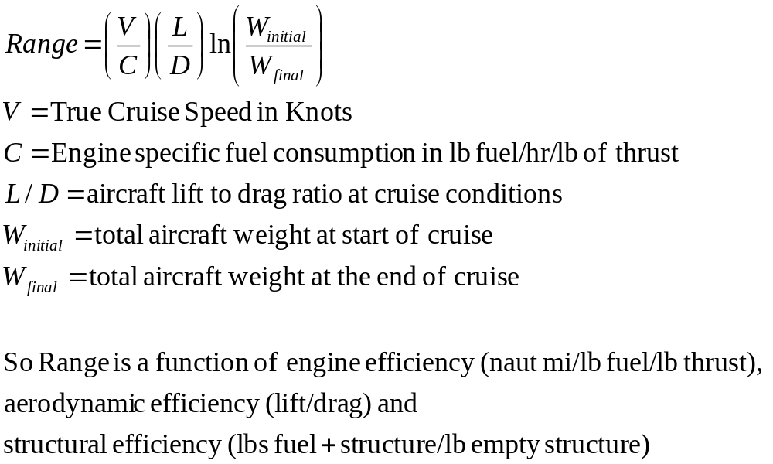
Defining Equation – Breuget Range Equation for jet engine aircraft

Slide 23
Requirements Analysis
Typically we would perform a requirements analysis around possible values to understand cost versus benefit
New York to London – 3103 naut mile
Historical search (Schaufele’s The Elements of Aircraft Preliminary Design, Aries Publications, 2000)
  L/D for large commercial transports varies between 15.0 and 18.2
  Typical weights ratios for a commercial airliner varies from 1.2 (Airbus 310-200) to 1.8 (Boeing 747-400)
  Typical cruise airspeed is 460 knots – 7 hour flight
  Typical jet engine fuel rate is .6 lb/hr/lb of thrust
Range of Performance
  Every variable picked at best for range = 8130 nmi
  Every variable picked at worst for range = 2078 nmi
Design Solution with max L/D, everything else minimum value, range = 2543 nmi
Design Solution with max structural efficiency, everything else minimum, range = 6759 nmi

Slide 24
One Possible Solution
A potential solution is
  Empty weight = 392,000 lbs,
  Passenger Weight = 88,00 lbs (275 lbs per passenger (passenger, baggage, food, water, other personal items) plus 20 person crew),
  Fuel weight = 389,000 lbs with a resulting weight ratio of 1.8 (Boeing 747)
  L/D = 15.0, Cruise Speed = 460 knots, Fuel rate = .8
  Range = 5069 nmi – requirementt + 60%
    50% margin in this equation would be normal at the start of a design

Slide 25
Requirements Decomposition
Range Requirement
300 passengers
for 3103 n mi
in 8 hrs
Aerodynamic
Efficiency
Requirement
L/D=15
Cruise airspeed =
460 knots
Structural
Efficiency
Requirement
Weight Ratio = 1.8
Propulsion
Efficiency
Requirement
C = .8,
Cruise airspeed =
460 knots
Fuel
Capacity
Requirement
389,000 lbs
Notes:
So the total range requirement turns into subsystem requirements in aerodynamics, structure, propulsion and fuel capacity.
There are many possible solutions for the range requirement. An important role of the system engineer is to model the requirement and make sure that each subsystem can meet its allocation so that the total system level requirement is met.
Where a model implies a requirement, it often is called a derived or child requirement.

Slide 26
Bottom Line
The best requirements have modeling or analysis that substantiate them.
Sometimes the best place to explain the rationale or model substantiation is in in requirements document right beneath the requirements. Such rationale is usually in italics.
The purpose of decomposition is to understand how top level requirements flow into requirements for lower level components

Slide 27
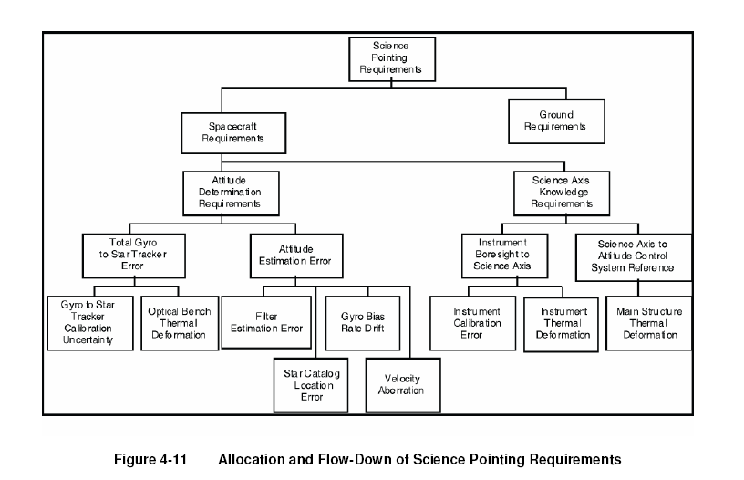
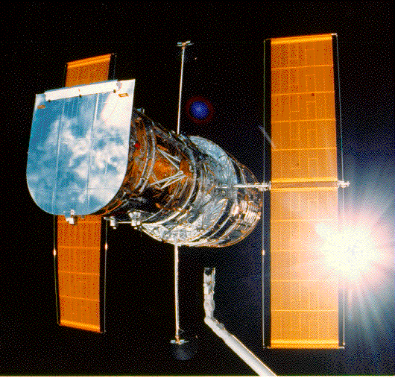
Satellite Requirements Decomposition – Space Telescope
Notes:
Here is an interesting requirements flowdown tree for the Hubble Space Telescope. For the Hubble to work, it must be accurately pointed. There are therefore system level (top level) pointing requirements in terms of a few fractions of a degree. But many items contribute to trhe accuracy of the pointing and each of these must be given an error budget or tolerances to meet.
In particular there are two major sources of error. The first is in the accuracy of how well Hubble knows where it is pointing. If it can only measure to a degree for example, how can it have accuracy below a degree.
The second is the accuracy of the mounting of the science instruments to the Hubble. Clearly if the instrument is misaligned to the Hubble, you might accurately point the Hubble but the instrument would be pointing somewhere else. This sounds simple but the relative alignment of these items changes as the spacecraft flies and is exposed to different thermal environments – remember it is in parts of a degree.
This chart shows how the total error budget is allocated to all of the relevant components on the Hubble so that the total error adds up to less than the system level spec.

Slide 28
A,B and C Requirements & Derived Requirements
Several levels of requirements normally exist in a system
Level of detail distinguishes the levels of requirements
Typically level A are system top level requirements – e.g. aircraft shall have 300 NM range
Level B are intermediate level of detail – aircraft shall carry 389,000 lbs of fuel
Level C are typically design-to requirements – aircraft shall carry fuel in 5 fuel tanks, 2 in wing and 3 in fuselage to allow proper cg management at any fuel loading
Derived requirements are those which are not explicitly stated but which can be determined from application of engineering or mathematical principles to the stated requirements
  E.g. fuel tanks in the wing shall be able to carry 100,000 lbs of fuel
INCOSE Def - Derived Requirements. Those characteristics typically identified during synthesis of preliminary product or process solutions and during related trade studies and verifications. They generally do not have a parent function and/or performance requirement but are necessary to have generated system elements accomplish their intended function.
Carnegie Mellon CMMI definition - "Requirements that are not explicity stated in the customer requirements, but are inferred from contextual requirements (e.g. applicable standards, laws, policies, common practices, and management decisions), or from requirements needed to specifiy a product component. Derived requirements can also arise during analysis and design of components of the product or system.

Slide 29
TBD and TBR
A generally bad practice but sometimes you just have to do it
TBD – to be determined – placed in a requirements statement
  Example - The aircraft will be able to fly TBD miles unrefueled
TBR – to be resolved – placed after a requirements statement that is not finalized or over which there is controversy
  Example – The aircraft will be able to fly unrefueled around the world (TBR)
Typically TBD’s and TBR’s are catalogued in a table at the end of a requirements document and tracked to resolution
  A plan should exist to get to resolution on each one
In many cases a TBD or TBR represents something that people feel there should be a requirement about, but about which there is not sufficient knowledge to write a firm requirement
Often projects have unresolved TBDs – this is an opportunity for bad things to happen
  Shuttle requirements still have many TBDs after 30 years of flying
  Requirements with TBDs don’t really help anything – they don’t drive design and they can’t be verified
This should be viewed as a stopgap measure at best

Slide 30
Traceability Matrices
This is a table that links requirements to other items such as
  Top level driving requirements or lower level more detailed requirements
  Verification plans or verification tests
There is not much engineering in this, it is book-keeping
They should be done at key milestones to make sure everything tracks
They are good hygiene but no more than that

Slide 31
Any Questions ?

